Slide 1
WOMEN IN MANUFACTURING
Impact of Women in Industrial Competitiveness
Cristina Oyón
Technology, Innovation and Sustainability Director - SPRI Group

Slide 2
Agenda
Objectives and methodology of the study
Key messages emerging from the survey to the Basque companies

Slide 3
The White Paper 2023 is the last work carried out by SPRI in the context of the Women in Manufacturing Expert Group
"Women in Manufacturing" Expert Group was created in 2020 by the World Manufacturing Foundation for closing the gender gap in the manufacturing industry. The Expert Group, led by Cristina Oyón (SPRI), has issued three white papers aimed at meeting the group’s objectives:
The “White Paper 2020 – Manufacturing beyond Covid”, with the objective to analyse the situation of women in the industry and establish recommendations in order to rebalance the gender gap after the Covid-19 sanitary crisis.
The “White Paper 2021 – Emerging topics for long term resilience in manufacturing”, on the identification of good practices to boost the access, promotion and leadership of women in the manufacturing sector.
The “White Paper 2023 – Impact of Women in Industrial Competitiveness”, which aims to address the correlation between gender equality in the industry and industrial competitiveness.

Slide 4
Objectives of SPRI 2023 Study on the Impact of Women in Industrial Competitiveness
Different studies suggest that gender diversity in companies is correlated with profitability, by strengthening the assumption that the inclusion of women increases the competitiveness of companies
The White Paper on Impact of Women in Industrial Competitiveness aims to verify empirically the above thesis with a twofold objectives:
To provide a framework of assessment to analyse the correlation between gender equality and competitiveness
To provide an objective basis that helps proving that a higher rate of gender diversity benefits the management of companies as their profitability and competitiveness
In order to verify the correlation, a scalable international methodology has been created and validated by SPRI, in collaboration with the WMF Expert Group
The methodology has been tested in the Basque Country (who stands out for the high weight of the industry in its GDP, 23.9%, and its innovation profile.

Slide 5
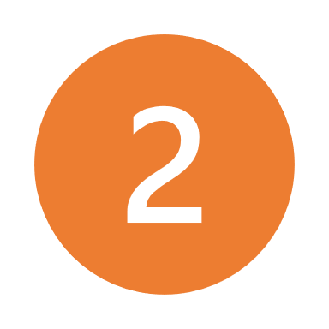
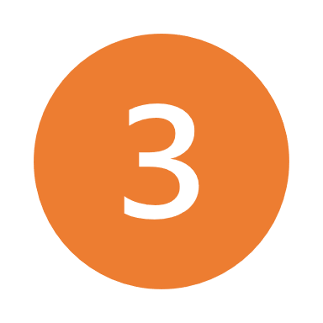
Methodology
The study developed by SPRI is structured in three steps:
To collect data, the methodology is based on a survey composed by three main blocks, that study the key elements related to equality and competitiveness of companies:
block 1: concerns the company characteristics
block 2: involves the Indicators of competitiveness and includes questions about R&D, innovation and Internationalization
block 3: consists of gender equality questions in terms of participation, employment relationship, work-life balance policies and governance
Data collection
Analysis framework
Drawing of conclusions

Slide 6
Methodology: the sample of the survey
A total of 474 companies have attended the survey
Characteristics of the sample:
every company is located in the Basque Country
all companies operate in the industrial and/or industrial-related services sector and participated in Innovation and/or R&D and/or Internationalization projects with public support
most of the companies (34,3%) have between 20 and 49 employees
about 70% of the sample records revenues in a range between 1 and 10 million of euros (only the 10% of the companies has a billing volume greater than 30 million of euros)
the 70% of the sample has a percentage of women in the company less than or equal to 40%
one in two companies has a rate of women in a managerial position less than 20%

Slide 7
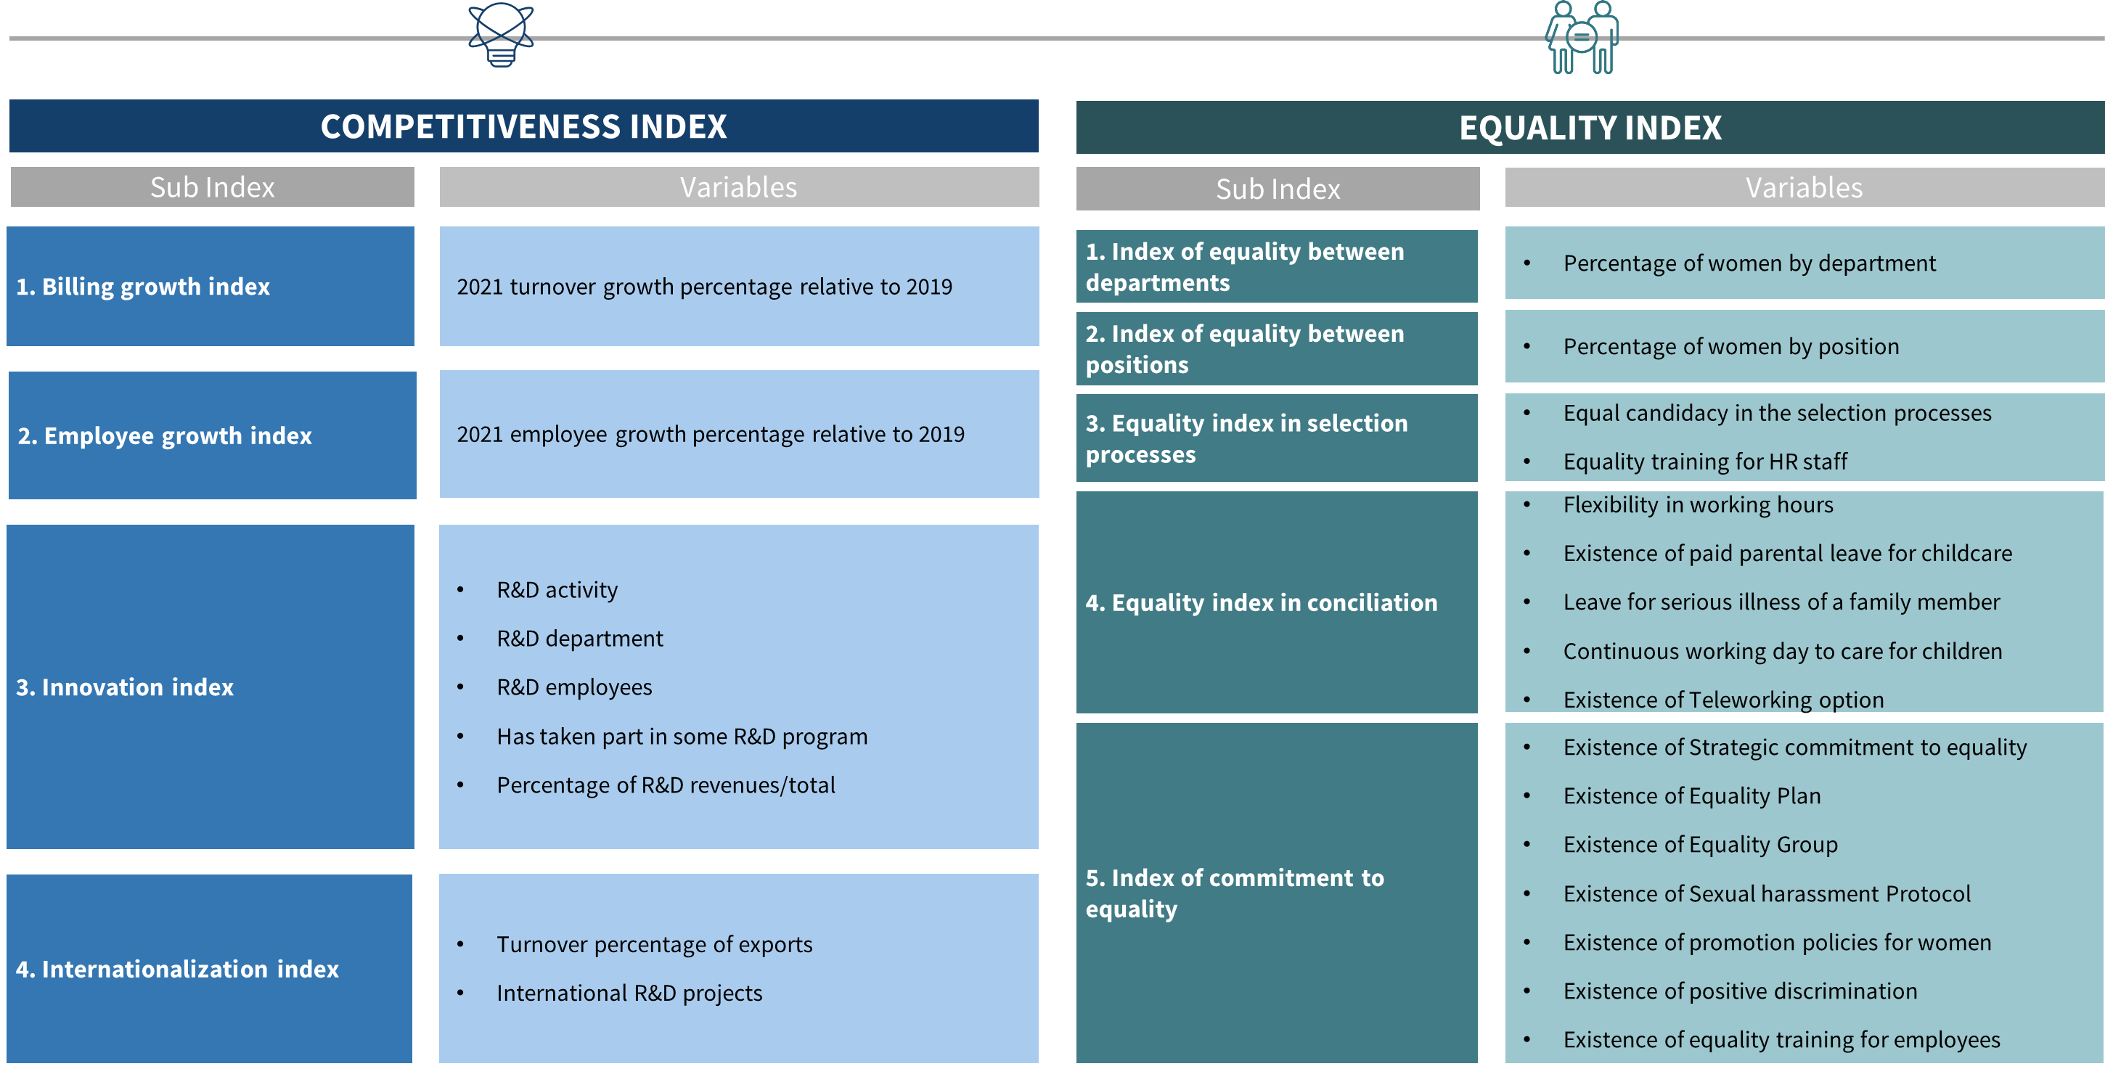
The Competitiveness and Equality Indexes
In order to deeply analyze the existence of a possible correlation between competitiveness and equality, two different composite indexes have been calculated on the basis of the data collected by the survey
In

Slide 8
Agenda
Objectives and methodology
Key messages emerging from the survey to the Basque companies
Competitiveness view
Equality view

Slide 9
Competitiveness view

Slide 10
The survey confirms that the most egalitarian Basque companies are more competitive than the least egalitarian
Competitiveness Index of companies according to the equality ranking
Trend
NB: The indexes in the chart shows the average results for each group. The dataset has been distributed by quintiles. The index range is between 0 (Min) and 1 (Max).

Slide 11
The most egalitarian companies have grown more than the least egalitarian (more than 10% during the ’19-’21 period)
’19-’21 Billing and Employment Growth Sub-Index according to the equality ranking

Slide 12
The most egalitarian companies show a level of R&D intensity significantly higher than the least egalitarian
R&D Intensity Sub-index Average of Companies according to the Equality Ranking
NB: The indexes in the chart shows the average results for each group. The dataset has been distributed by quintiles. The index range is between 0 (Min) and 1 (Max).

Slide 13
The most egalitarian companies are more projected on the international business scenario than the least competitive
Average Internationalization Sub-index of Companies according to the Equality Ranking
NB: The indexes in the chart shows the average results for each group. The dataset has been distributed by quintiles. The index range is between 0 (Min) and 1 (Max).

Slide 14
Key messages
Companies with higher gender inclusion are more competitive
The most egalitarian companies have grown more than the least egalitarian companies both in terms of turnover and employment (’19-’21)
R&D intensity in the most egalitarian companies is significantly higher than the least egalitarian companies
The most egalitarian companies are more projected on the international business scenario than the least competitive ones

Slide 15
Equality View

Slide 16
The survey confirms that the most competitive Basque companies are more egalitarian than the least competitive
Equality Index of companies according to the competitiveness ranking
Trend
NB: The indexes in the chart shows the average results for each group. The dataset has been distributed by quintiles. The index range is between 0 (Min) and 1 (Max).

Slide 17
Most competitive companies have more gender-balanced departments
Least competitive vs. most competitive: 40%-60% men to women ratio of employees by departmet
*The focus on this range is explained by its greater representativeness of gender equality compared to all other ranges of the same index

Slide 18
Most competitive companies have more gender-balanced structure by role/position
Least competitive vs. most competitive: 40%-60% men to women ratio of employees by role​
*The focus on this range is explained by its greater representativeness of gender equality compared to all other ranges of the same index

Slide 19
Most competitive companies apply more work-life balance policies more efficiently
Work-life Balance Sub-Index according to the competitive ranking
Trend
NB: The indexes in the chart shows the average results for each group. The dataset has been distributed by quintiles. The index range is between 0 (Min) and 1 (Max).

Slide 20
Most competitive companies show greater commitment to promote women and the implementation of gender-based policies
Inclusivity by governance Sub-Index according to the competitive ranking
Trend
NB: The indexes in the chart shows the average results for each group. The dataset has been distributed by quintiles. The index range is between 0 (Min) and 1 (Max).

Slide 21
Key messages
The most competitive companies are more egalitarian than the least competitive ones
The enhancement of women in different roles and departments supports the competitive development of companies
Work-life balance policies are fundamental in order to make companies more egalitarian and by consequence more competitive.
Most competitive companies have greater governance commitment to gender equality.

Slide 22
WOMEN IN MANUFACTURING
Impact of Women in Industrial Competitiveness
Cristina Oyón
Technology, Innovation and Sustainability Director - SPRI Group

