Slide 1


SME Feedback, Nuevos enfoques, nuevas herramientas

Slide 2

WHAT
TG SME Feedback will dinamise and support the activities developed by the EEN in order to be a key communication channel for SMEs to the Commission, bridging the gap between SMEs and EU policy making in general, and, specifically, on resilience and triple transition policy design; both, top dow and bottom up, working closely with DG Grow and EISMEA to impulse a more agile SME Feedback mechanisim.
Notes:
We are at the heart of the EU’s growth and jobs strategy.
We already have many years’ experience and have built up significant expertise and strong connections since our launch in 2008.
The Network entered a second phase in 2015, which brought new financing under the COSME and Horizon 2020 programmes as well as exciting new innovation services that we also provide for SMEs.
This demonstrates the continued importance and value of the trusted services that we provide.
In figures, the combined total funding is 180 million EURO.

Slide 3







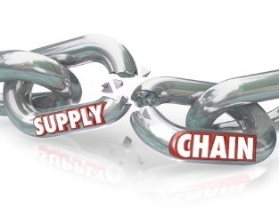
ON
Channeling SMEs voice to the Commission
Anticipate concerns, trends, problems
Gather information
Bridging the gap with rules and formalities
Address Single Market obstacles
Notes:
Concretely, the Network’s role in relation to the Single Market is to help SMEs anticipate rules and formalities when selling goods and services across borders in the EU, and to tackle immediate obstacles they are faced with.
The Network's Single Market advisers shall also help SME clients if they are facing difficulties exercising their rights under EU law.
For example, SMEs may need the Network’s support to :
• Find out about the applicable rules to sell goods and services across borders (free movement of goods and services, e-commerce, posting of workers, etc.)
• Make sure that their product complies with the applicable EU legislation (standards, CE marking, REACH, etc. )
• Take part in public tenders in other EU countries
• Figure out how to comply with taxation rules when trading across EU borders (VAT, excise, etc.)
• Protect their intellectual property rights, …etc.

Slide 4
HOW
TOP DOWN Approach
SME Pannels & Consultations
BOTTOM UP Approach
Surveys & Questionnaires sent by EEN to the SMEs
SME data base
Other channels: Solvit, yea, ad-hoc initiatives
Surveys within the network addressed to
Notes:
No personal data collected (i.e. GDPR not applicable). Feedback on the feedback is provided by the EEN partner to their client, where applicable.

Slide 5


HOW
CORE GROUP
Top Down
Task Force
Bottom Up
Task Force
Client Journey & KPIs
Task Force
Main goal: to get a more agily SME Feedback mechanism
Mail goal: start to develop it
Design actions at the consortia level that can be scalable
Main goal: to include it as a part of the client journey. KPIs accordingly. Define how and when
Notes:
The key messages below support your explanation of Network services. You can mention that later in the presentation you will give examples of how these services work in practice.
PARTNERSHIP
Through direct access to Europe’s largest dbase of business opportunities, our experts help SMEs forge new international partnerships with excellent growth potential
- We organise fast and effective matchmaking and brokerage events at international conferences to save clients time and money
Our tailor-made trade missions lead to successful partnerships thanks to thorough preparation, local knowledge and expert guidance.
ADVISORY
Our experts have the right advice to support SMEs’ growth ambitions
Whatever your business, we can advise on the best market opportunities to help you expand internationally
We cut through the complexities of international expansion by providing practical advice, targeted market intelligence and personalised support.
INNOVATION
We recognise innovation potential and help SMEs shape it into commercial success
Our experts help SMEs commercialise their innovations faster
With our practical, personal advice SMEs are confident to expand internationally protecting their ideas and assets as they grow.

Slide 6
WHY
More than ever SME feedback is needed.
In 2022, the Commission committed to ensure that there is ‘feedback to the feedback’.
SME Feedback is horizontal, affecting all the issues related to single market and other policies. SME feedback group cooperates and cocreate with other groups and issues apart from SM.
EU Survey on SM events. 30th SM anniversary. https://een.ec.europa.eu/connect/article/eu-survey-enterprise-europe-network-single-market-events
Scale ups
Open survey
Next: resilience
Notes:
… This means that we are able to maintain a strong local knowledge that keeps us close to our SME clients, while also offering the range of international expertise that helps these innovative small businesses to achieve their ambitions.

Slide 7
TG Mandate
1
2
3
4
Enhance the role of our Scaleup Advisors
Address the needs of high growth potential SMEs
Develop services and activities with higher standards of services
Improve the EEN brand across the startup and scaleups ecosystems
Notes:
We are good advisors and have the differential asset of the Network but we need New tools, capacity building, coaching techniques, to stay competitive enough
Thus we will help our clients better
Also to develop and fine-tune our e.g. Scaleup Programmes, my example…
Improve the brand and be a reference not only for consolidated innovative clients but also startups and scaleups with high growth potential

Slide 8
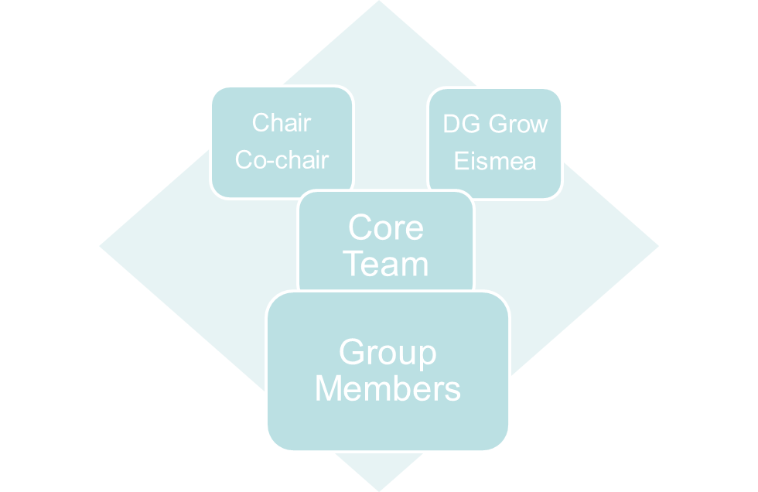
Structure and evolution
Chair
DG Grow
Eismea
Core Team
Group Members
Vice-chair
Vice-chair
WG1
WG2
WG3
WG4
WG5
Notes:
EG W1. open innovation/sharing profiles
W2 Specific Bes for startups, e.g. challenge solvings for corporates
W3 Update on Opportunities for funding for startups (eg. Cascade Funding, EICcalls, Pitching events)
W4. EIT arsing from the EIT opportunities

Slide 9
Domains
Explore
Continuos mapping of best practises in/outside the EEN
Learn
Design of specific training sessions for our Scaleup advisors
Connect
Internal cooperation within the TG
Cooperation with EU related initiatives
Cooperation with SGs/TGs
Implement
Implement joint activities for startups and scaleups within the Core Team
Communicate
Increase the visibility of EEN services for startups and scaleups
Notes:
INTERNAL COOPERATION IS THE KEY AT THE PRESENT STATE
START DOING THINGS
IMPLEMENT ACTIVITIES
1.Capacity Building -( What topics/training should the TG focus on)
2.EU Funding – (mapping the overview of funding opportunities, calls related to start ups and scale ups, EIC calls..)
3.Partnering and services – (Collect and share companies profiles and identify in-depth services for Start-ups and scale ups)
4.Communication and Stakeholders (Rolling plan, information about brokerage events, Linkedin, collaboration with Stakeholders of the Start-ups and Scale ups ecosystem (Start-up Europe, EBAN, RAISE etc..)
5.Cross Collaboration –( Collaboration and synergies with other TGS and SGs, mapping of cross memberships, potential joint events )

Slide 10
Thematic Groups
New Innovation agenda
TG Startup & Scaleup
Sector Groups
#EENCanHelp
EU Initiatives
Synergies
National
Regional Initiatives
Notes:
The New European Innovation Agenda, in a nutshell aims to address the EU challenges (Energy, Mobility, Health, Climate Change…) through fostering a package of measures the development of deeptech startups and scaleups across EU
improve access to finance for European start-ups and scale-ups, for example, by mobilising untapped sources of private capital and simplifying listing rules
improve the conditions to allow innovators to experiment with new ideas through regulatory sandboxes
help create “regional innovation valleys” that will strengthen and better connect innovation players through Europe, including in regions lagging behind
attract and retain talent in Europe, for example by training 1 million deep tech talents, increasing support for women innovators and innovating with start-up employees’ stock options
improve the policy framework through clearer terminology, indicators and data sets, as well as policy support to Member States
.
EU INITIATIVES
EIC
EIT
Startup Europe
Startup Europe is an initiative of the European Commission to connect high tech startups, scaleups, investors, accelerators, corporate networks, universities and the media.
This initiative has had the capacity to unite start-up ecosystems across Europe, and to launch a truly convergence movement to build a “start-up-friendly Europe”, through projects and other initiatives.
It is supported by a portfolio of EU fundedprojects and policy actions
Continue to further collaboration with Startup Europe and develop cooperation and synergies with the new European Startup Nations Alliance (ESNA);
Our TG will continue to cooperate with this initiative. We already achieved an important milestone this month with a collaboration with the RAISE project with ESNA, EBAN, EURADA..so we hit several targets with one stone :)
COOPERATION WITH TG DIGITALISATION With the focus on startups active in the Digital Sector offering digital solutions, ALSO TROUGH AN EU JOINT GROUP OF EEN-EIDHS-STARTUP EUROPE-EU CLUSTERS
COOPERATION WITH Research and INNOVATION
COOPERATION WITH A2F & WOMEN ENTREPRENEURS

Slide 11
Learn
Connect
Implement
Make it visible
Explore
Virtuose circle
Notes:
Develop joint cross-border programmes and activities for the final recipients, co-organised by TG’S network partners in cooperation
“Own flagship initiative/programme for 2023.”
Maybe too ambitious so perhaps focus on real collaboration through the WGs

Slide 12
Milestones achieved
Enterprise Europe Network | 12
Already achieved:
27-04-2022 TG Kick-off meeting
                09-06-2022 TG Online Meeting and Workplan
26-10-2022 Workshop in the AC: Evolving EEN services for start-ups and scale-ups
10-11-2022 Online Traninig session Module-1: “Starting versus scaling a business,”
15-11-2022 Cooperation with TGs WE/A2F Pitching Event
23-01-2023 Cooperation with Startup Europe (RAISE Project) (ESNA, EURADA, EBAN)
15-02-2023 Core Team online Meeting
19-04-2023 Onsite Training with Module-2: “Coaching Scaling businesses”
Notes:
delineating differences and unique challenges faced by businesses at different phases in the entrepreneurial process from pre-start to achieving scale.
Startup Europe is an initiative of the European Commission to connect high tech startups, scaleups, investors, accelerators, corporate networks, universities and the media.
It is supported by a portfolio of EU funded projects and policy actions such as the EU Startup Nation Standard, Innovation Radar and the Digital Innovation and Scale-up Initiative (DISC).
to unite start-up ecosystems across Europe, and to launch a truly convergence movement to build a “start-up-friendly Europe”, through projects and other initiatives.
We participated
RAISE project--contributing to the establishment of a true EU startup ecosystem, not based on a single city or region, but linking all of them together.
We participated as EEN, showcasing policy instruments like our Scaleup programmes but also the EEN as a consolidated UE initatiative that has a say within the EU Innovation Agenda
RAISE - Regions’ Alliances for Interconnected Start-up Ecosystems (RAISE)
2nd Co-creation Workshop The New European Innovation Agenda, Start-ups and its Scale-up

Slide 13
Next steps for 2023
Enterprise Europe Network | 13
CONNECT & IMPLEMENT: To start cooperating among ourselves within the TG in the benefit of our startups, and scaleups setting up 3/4 active Subgroups/WGs (profiles, BEs, funding for startups, EIT)
CONNECT: Select a candidate (double-agent) to connect to TG Digitalisation and start real cooperation, e.g., help startups driving change for SMEs in their digital transformation.
CONNECT: Strengthen cooperation with TG Research & Innovation (Natalia Mozo)
IMPLEMENT: Organise the 2023 pitching event in for WE with TGs WE & A2F and EBAN.

Slide 14
Next steps for 2023
Enterprise Europe Network | 14
LEARN: Organise a decentralized training for scaleup advisors
CONNECT & COMMUNICATE: Act as a channel to connect our startups with the EIT opportunities, via signposting.
CONNECT: Keep an eye EIC 100 call, and Startup Europe, and explore cooperation and synergies with the new European Startup Nations Alliance (ESNA)
IMPLEMENT: TG contribution to the Annual Conference – Next TG Meeting

Slide 15
Three experiments SME-Feedback

Slide 16
Lean methodology
Google Forms (free versión)
ERDF grants database
Social Media
Linkedn Inmail Feature (only with premium versión)

Slide 17
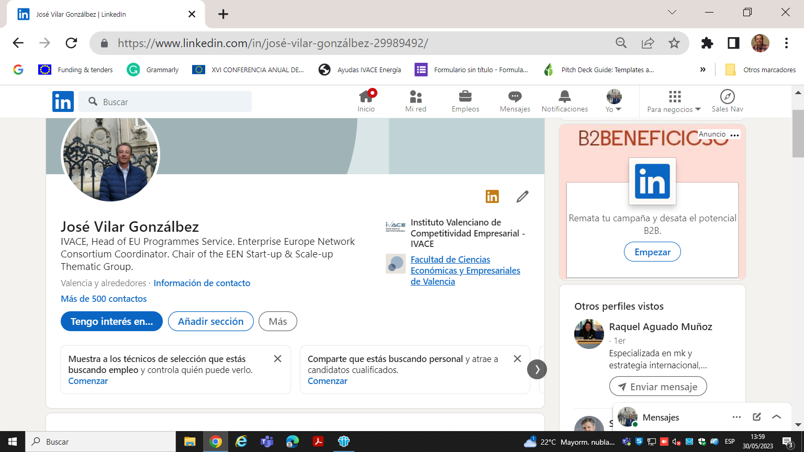
Linkdln Sales Navigator

Slide 18
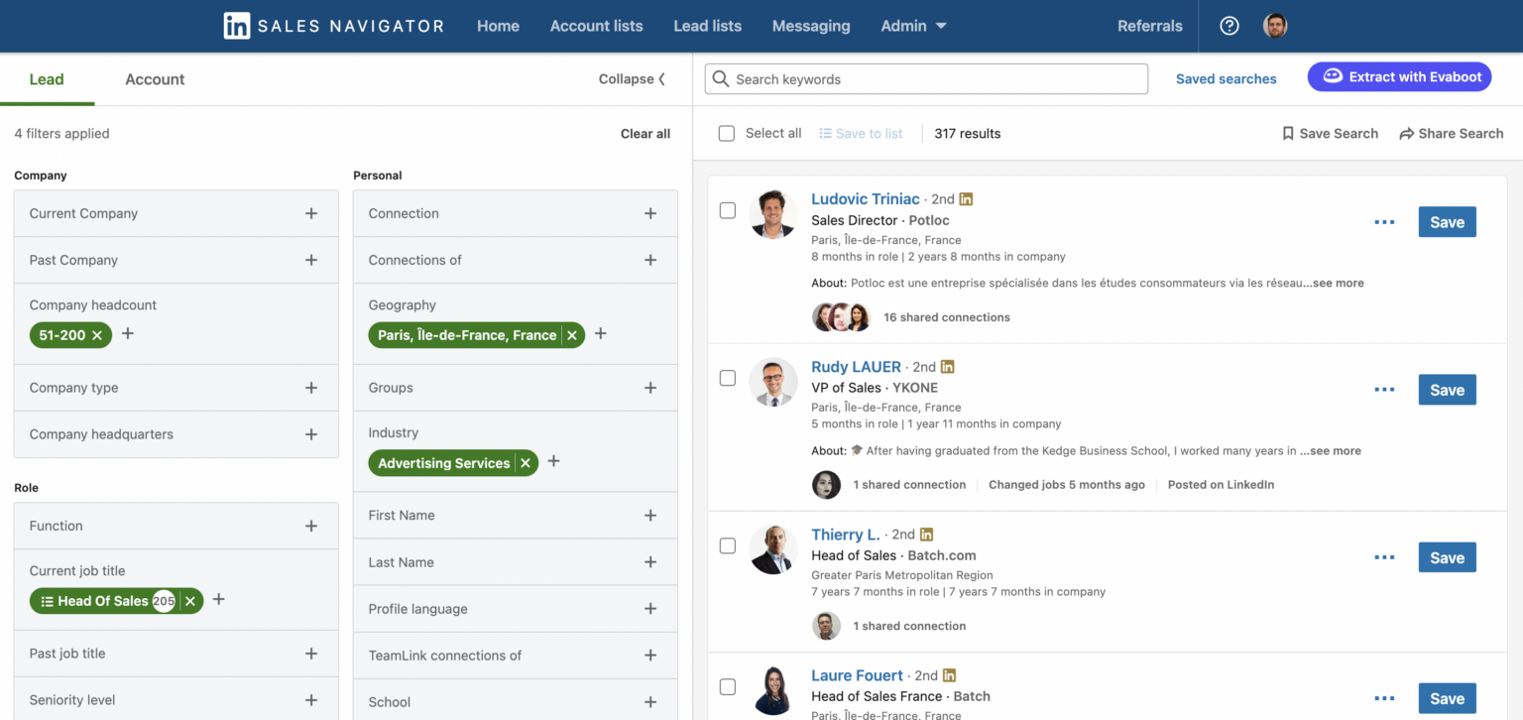
Linkdln Sales Navigator

Slide 19
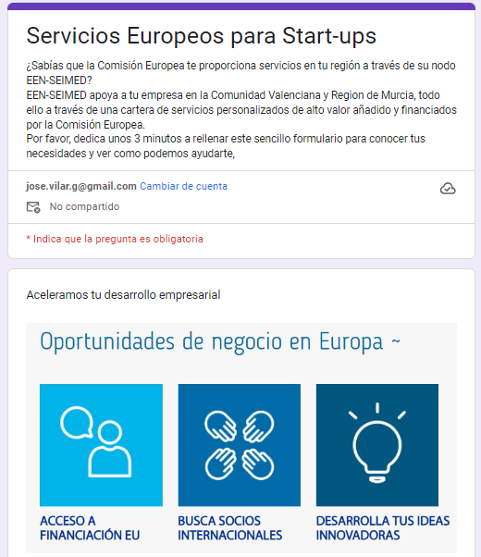
Lean methodology

Slide 20
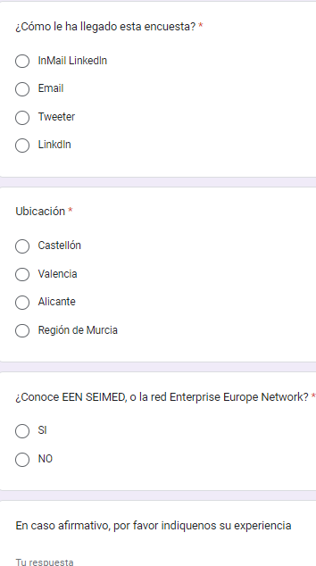
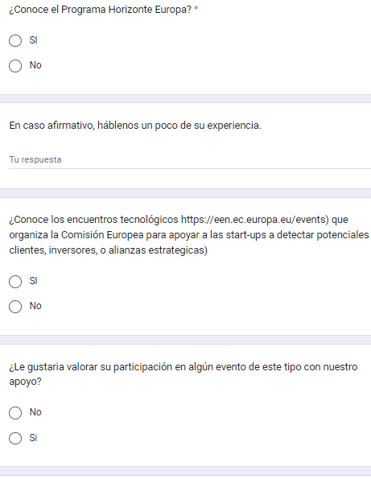

Slide 21
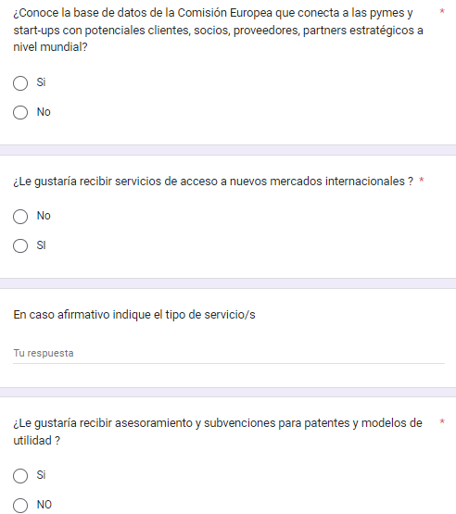
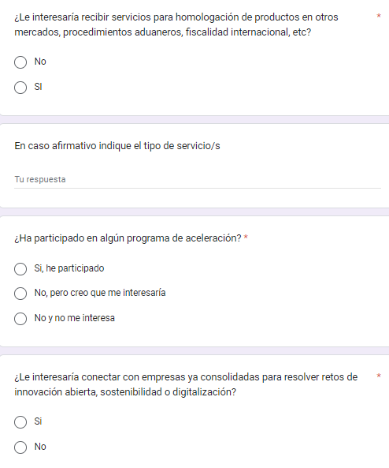

Slide 22
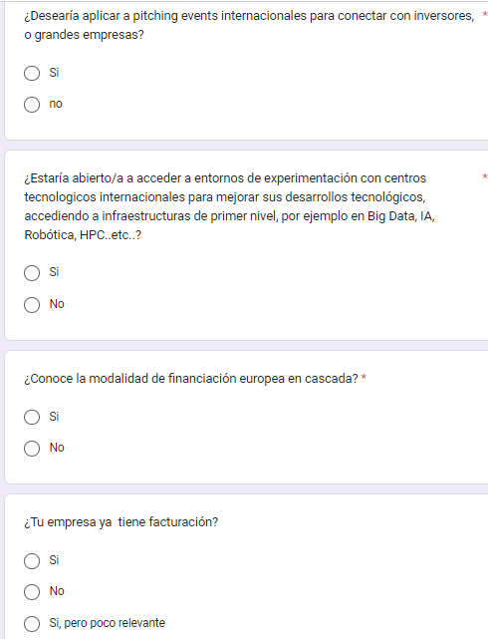
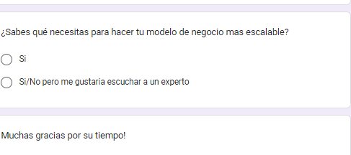
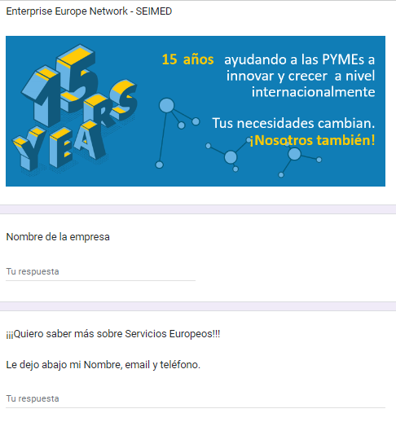

Slide 23
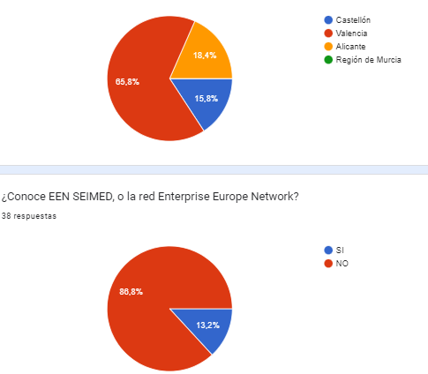
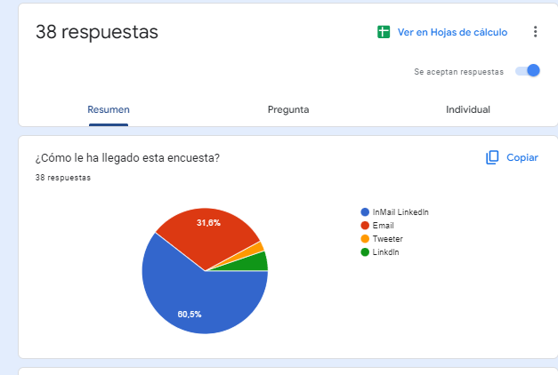
Results of the Survey

Slide 24
Some interesting conclusions
The EEN in our region is not visible enough for start-ups.
Our services and tools can be very useful for them.
We not only raise awareness but help us recruit some clients.
Mailings and social media per se not the best tools.
We need to engage with the client through new channels
In a second experiment we will include a few capsules of SME-Feedback, like barriers to do business, gaps of support in our ecosystem, resilience…
Commercial approach like our experiment is good to attract companies into SME-feedback but to convert them into clients of the EEN

Slide 25

Think bigger
WORK TOGETHER
Go further
Notes:
These are just some of my Network colleagues. We are here to help you so please don’t hesitate to get in touch.

Slide 26




Gracias
seimed@ivace.gva.es
www.seimed.eu
@seimedcv
@Seimed-CV_EEN
@eenseimedcv
SEIMED-EEN

