Slide 1
engineering & consultancy

Slide 2
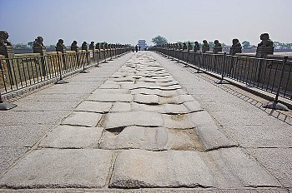
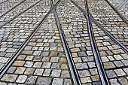
ABOUT US
MAGNA DEA is a Spanish SME company of engineering and consultancy in the fields of hydraulics, energy and environment
We work with:
water and wastewater (water supply, wastewater treatment, management…)
power generation & efficiency (steam processes, district heating …)
magna dea
www.magnadea.es

Slide 3
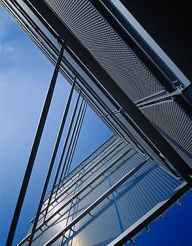
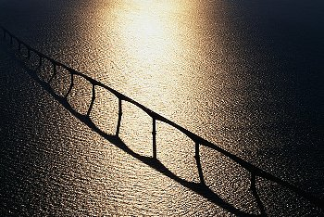
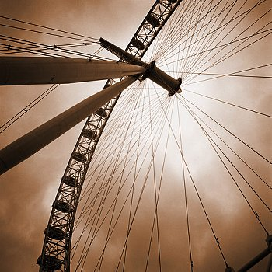
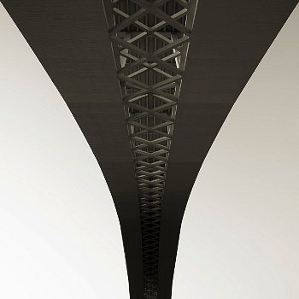
TEAM, R&D Projects
Our team includes…
Civil engineers
Chemical engineers
Industrial engineers
Electrical engineers
Technicians in Labor Risk Prevention
R&D under development:
Energy efficiency
Waste revalorization
Water quality control
Steam quality control
magna dea

Slide 4
ENN, Galactea, FICYT
magna dea

Slide 5
PARTNER SEARCH OPPORTUNITY FROM EEN
JUNE 2018
CONSORTIUM AGREEMENT
C-ICE-BIOHYDRO
magna dea

Slide 6
EUREKA EUROSTARS PROGRAMME
SEPTEMBER 2020
magna dea
C-ICE-BIOHYDRO PROJECT
14th position in the ranking out of 500 eligible applications

Slide 7
financing
MAY 2021
Spanish Call for Eurostars Programme
magna dea
“Convocatoria Interempresas Internacional 2021-1”
C-ICE-BIOHYDRO PROJECT

Slide 8
C-ice-biohydro pROJECT
C-ICE -BIOHYDRO
CERAMIC INTERNAL COMBUSTION ENGINE
BIOHYDROGAS
magna dea

Slide 9
IMPACT FOR MAGNA DEA
COSTS & FUNDING |  | TIMELINE
Overall Project cost | 579.373 € | Overall Project timeline | 25 monsths
Overall Project cost for Magna Dea | 228.557 € |  | Start: 1st May 2021
Funding approved for Magna Dea | 137.134 € | Total period of Magna Dea tasks | 20 months
magna dea
Partial Financial support

Slide 10
IMPACT FOR MAGNA DEA
magna dea
Know-how & visibility

Slide 11
THANK YOU FOR YOUR ATTENTION
magna dea

